Slide 1
Chapter 12 Perfect Competition and the Supply Curve
THIRD EDITION
MICROECONOMICS Paul Krugman | Robin Wells
>>
Notes:
1

Slide 2
What a perfectly competitive market is and the characteristics of a perfectly competitive industry
How a price-taking producer determines its profit-maximizing quantity of output
How to assess whether a producer is profitable and why an unprofitable producer may continue to operate in the short run
Why industries behave differently in the short run than in the long run
What determines the industry supply curve in both the short run and the long run
WHAT YOU
WILL LEARN
IN THIS CHAPTER
Notes:
2

Slide 3
Perfect Competition
A price-taking producer is a producer whose actions have no effect on the market price of the good it sells.
A price-taking consumer is a consumer whose actions have no effect on the market price of the good he or she buys.
A perfectly competitive market is a market in which all market participants are price-takers.
A perfectly competitive industry is an industry in which producers are price-takers.
Notes:
3

Slide 4
Two Necessary Conditions for Perfect Competition
1. For an industry to be perfectly competitive, it must contain many producers, none of whom have a large market share.
A producer’s market share is the fraction of the total industry output accounted for by that producer’s output.
2. An industry can be perfectly competitive only if consumers regard the products of all producers as equivalent.
A good is a standardized product, also known as a commodity, when consumers regard the products of different producers as the same good.
Notes:
4

Slide 5


One Long Run Condition: Free Entry and Exit
There is free entry and exit into and out from an industry when new producers can easily enter into or leave that industry.
Producers in an industry cannot artificially keep other firms out.
Free entry and exit ensures:
the number of producers in an industry can adjust to changing market conditions; and
profits in the industry are not excessive
Notes:
5

Slide 6
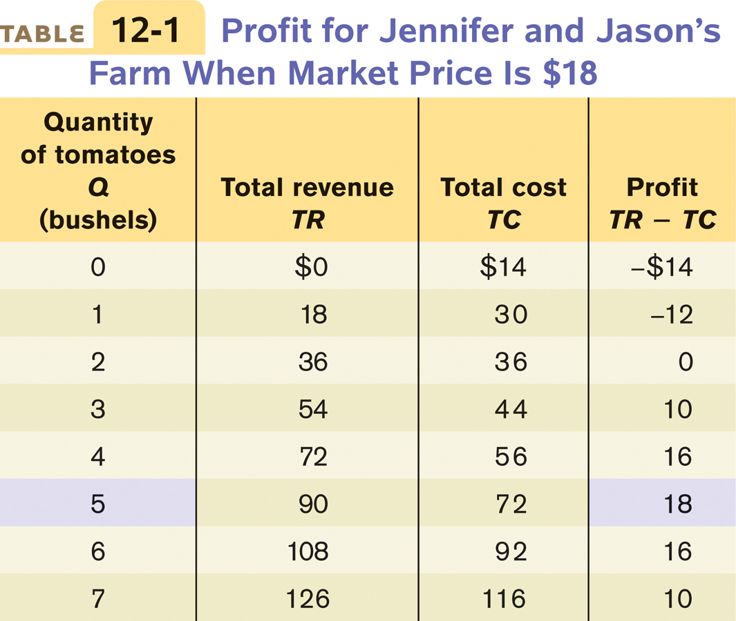
Production and Profits
6
Notes:
6

Slide 7
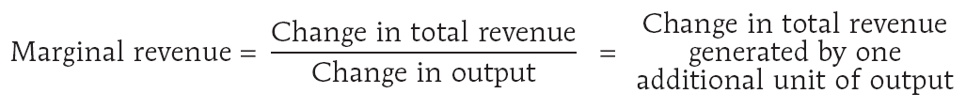
The Optimal Output Rule
Marginal revenue is the change in total revenue generated by an additional unit of output.
MR = ∆TR/∆Q
The optimal output rule says that profit is maximized by producing the quantity of output at which the marginal cost of the last unit produced is equal to its marginal revenue.
Notes:
7

Slide 8
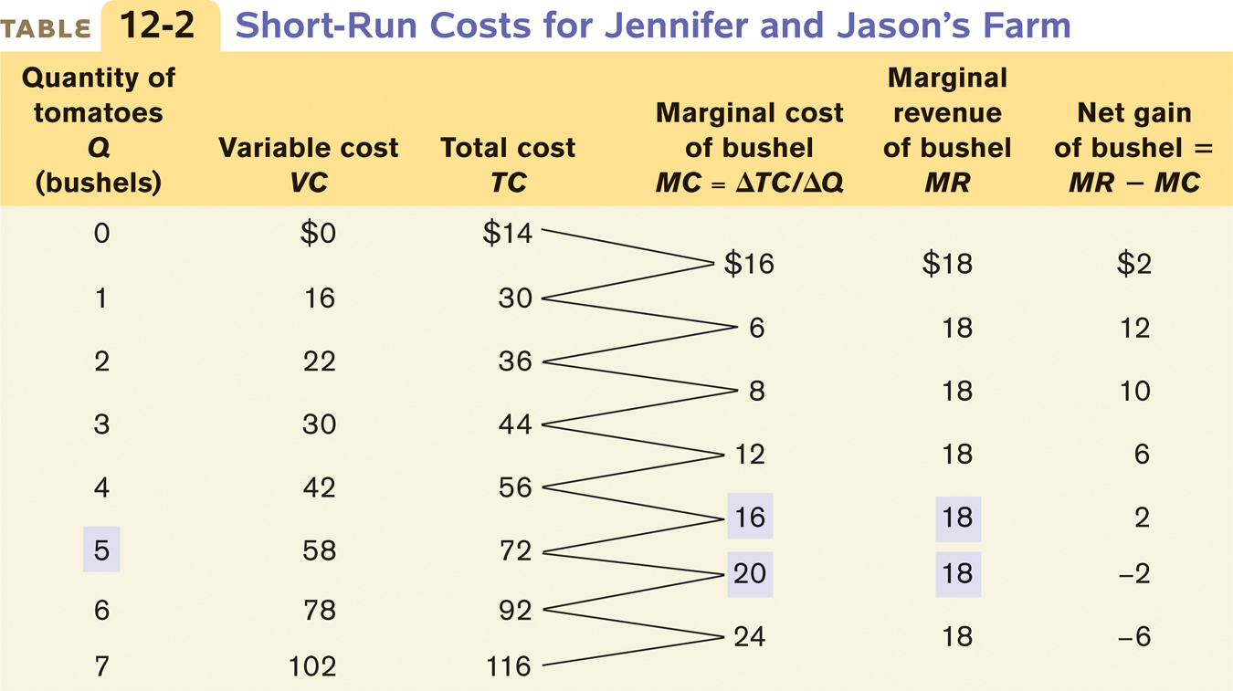
Short-Run Costs for Jennifer and Jason’s Farm
Notes:
8

Slide 9

Marginal Analysis Leads to Profit-Maximizing Quantity of Output
The price-taking firm’s optimal output rule says that a price-taking firm’s profit is maximized by producing the quantity of output at which the marginal cost of the last unit produced is equal to the market price.
Marginal revenue (MR) is the additional revenue that comes from producing and selling 1 more unit
The marginal revenue curve shows how marginal revenue varies as output varies.
If I increase production, can I sell my additional production for enough to cover my additional costs?
Notes:
9

Slide 10
The Price-Taking Firm’s Profit-Maximizing Quantity of Output
Price, cost of bushel
Optimal point
MC
$24
Market price
20
E
18
MR
=
P
16
12
8
6
0
1
2
3
4
5
6
7
Quantity of tomatoes (bushels)
Profit-maximizing quantity
The profit-maximizing point is where MC crosses the MR curve
(horizontal line at the market price): at an output of 5 bushels of tomatoes (the output quantity at point E).
Notes:
Figure Caption: Figure 12-1: The Price-Taking Firm’s Profit-Maximizing Quantity of Output
At the profit-maximizing quantity of output, the market price is equal to marginal cost. It is located at the point where the marginal cost curve crosses the marginal revenue curve, which is a horizontal line at the market price. Here, the profit-maximizing point is at an output of 5 bushels of tomatoes, the output quantity at point E.

Slide 11
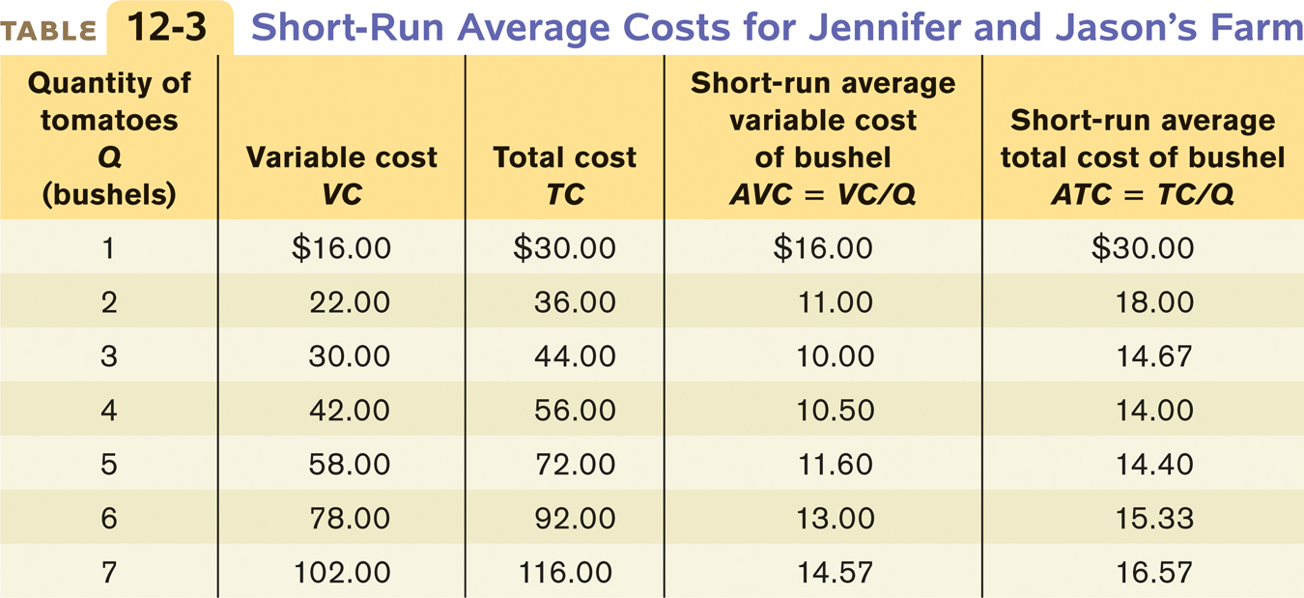
Short-Run Average Costs
When Is Production Profitable?
If TR > TC, P > ATC, the firm is profitable.
If TR = TC, P = ATC, the firm breaks even.
If TR < TC, P < ATC, the firm incurs a loss.
Notes:
11

Slide 12
Costs and Production in the Short Run
At point C (the minimum average total cost), the market price is $14 and output is 4 bushels of tomatoes (the minimum-cost output).
Price, cost of bushel
$30
MC
Minimum average total cost
18
A
T
C
Break even price
C
14
MR
=
P
0
1
2
3
4
5
6
7
Quantity of tomatoes (bushels)
Minimum-cost output
This is where MC cuts the ATC curve at its minimum. Minimum average total cost is equal to the firm’s break-even price.
Notes:
Figure Caption: Figure 12-2: Costs and Production in the Short Run
This figure shows the marginal cost curve, MC, and the short-run average total cost curve, ATC. When the market price is $14, output will be 4 bushels of tomatoes (the minimum-cost output), represented by point C. The price of $14, equal to the firm’s minimum average total cost, is the firm’s breakeven price.

Slide 13
Profitability and the Market Price
The farm is profitable because price exceeds minimum average total cost, the break-even price, $14. The farm’s optimal output choice is (E) → output of 5 bushels. The average total cost of producing bushels is (Z on the ATC curve) →$14.40.
The vertical distance between E and Z:
farm’s per unit profit, $18.00 − $14.40 = $3.60
Total profit: 5 × $3.60 = $18.00
Price, cost of bushel
Market Price = $18
Minimum average total cost
MC
E
$18
MR
=
P
14.40
Profit
A
T
C
Break even price
14
C
Z
0
1
2
3
4
5
6
7
Quantity of tomatoes (bushels)
Notes:
Figure Caption: Figure 12-3: Profitability and the Market Price
In panel (a) the market price is $18. The farm is profitable because price exceeds minimum average total cost, the breakeven price, $14. The farm’s optimal output choice is indicated by point E, corresponding to an output of 5 bushels. The average total cost of producing 5 bushels is indicated by point Z on the ATC curve, corresponding to an amount of $14.40. The vertical distance between E and Z corresponds to the farm’s per unit profit, $18.00 −$14.40 =$3.60. Total profit is given by the area of the shaded rectangle, 5 ×$3.60 =$18.00.

Slide 14
Profitability and the Market Price
Price, cost of bushel
The farm is unprofitable because the price falls below the minimum average total cost, $14.
The farm’s optimal output choice is (A) → output of 3 bushels.
The average total cost of producing bushels is (Y on the ATC curve) →$14.67.
Market Price = $10
Minimum average total cost
MC
$14.67
Y
A
T
C
Break even price
14
C
Loss
10
MR
=
P
A
The vertical distance between A and Y:
farm’s per unit loss, $14.67 − $10.00 = $4.67
Total profit: 3 × $4.67 = ~$14.00
0
1
2
3
4
5
6
7
Quantity of tomatoes (bushels)
Notes:
Figure Caption: Figure 12-3: Profitability and the Market Price
In panel (b) the market price is $10; the farm is unprofitable because the price falls below the minimum average total cost, $14. The farm’s optimal output choice when producing is indicated by point A, corresponding to an output of three bushels. The farm’s per-unit loss, $14.67 −$10.00 =$4.67, is represented by the vertical distance between A and Y. The farm’s total loss is represented by the shaded rectangle, 3 ×$4.67 = $14.00 (adjusted for rounding error).

Slide 15
Profit, Break Even, or Loss
The break-even price of a price-taking firm is the market price at which it earns zero profits.
Whenever market price exceeds minimum average total cost, the producer is profitable.
Whenever the market price equals minimum average total cost, the producer breaks even.
Whenever market price is less than minimum average total cost, the producer is unprofitable.
Notes:
15

Slide 16

Profit Maximization in the Short Run
Sunk cost
Sunk costs should be ignored when making decisions
Has already been committed; cannot be recovered
“No use crying over split milk”
At beach resorts, restaurants are near-empty on weekdays. Should they stay open?
Fixed costs
Not relevant
Are sunk costs in short run
Variable costs – relevant
Shut down if revenue on weekday < variable costs
Stay open if revenue on weekday > variable costs

Slide 17
The Short-Run Individual Supply Curve
Price, cost of bushel
The short-run individual supply curve shows how an individual producer’s optimal output quantity depends on the market price, taking fixed cost as given.
Short-run individual supply curve
MC
A firm will cease production in the short run if the market price falls below the shut-down price, which is equal to minimum average variable cost.
Break even price
$18
E
A
T
C
16
14
A
VC
12
C
B
Shut-down price
10
A
Minimum average variable cost
0
1
2
3
3.5
4
5
6
7
Quantity of tomatoes (bushels)
Notes:
Figure Caption: Figure 12-4: The Short-Run Individual Supply Curve
When the market price equals or exceeds Jennifer and Jason’s shutdown price of $10, the minimum average variable cost indicated by point A, they will produce the output quantity at which marginal cost is equal to price. So at any price equal to or above the minimum average variable cost, the short-run individual supply curve is the firm’s marginal cost curve; this corresponds to the upward sloping segment of the individual supply curve. When market price falls below minimum average variable cost, the firm ceases operation in the short run. This corresponds to the vertical segment of the individual supply curve along the vertical axis.

Slide 18
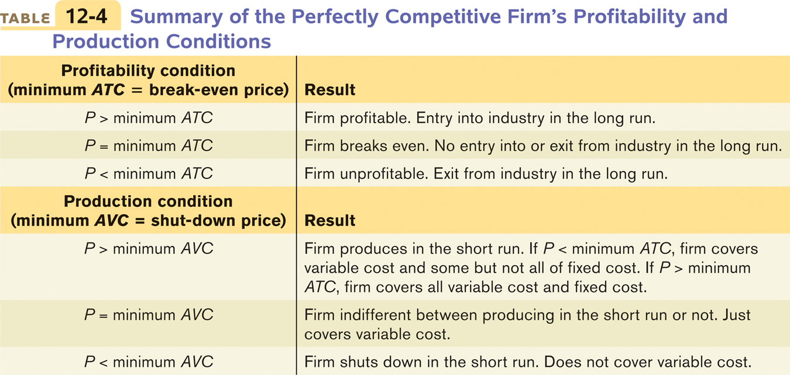
Summary of the Competitive Firm’s Profitability and Production Conditions
In the short run, the competitive firm’s supply curve is its marginal-cost curve (MC) above average variable cost (AVC).
If the price falls below average variable cost, the firm is better off shutting down.
Notes:
18

Slide 19
Industry Supply Curve
The industry supply curve shows the relationship between the price of a good and the total output of the industry as a whole.
The short-run industry supply curve shows how the quantity supplied by an industry depends on the market price given a fixed number of producers.
There is a short-run market equilibrium when the quantity supplied equals the quantity demanded, taking the number of producers as given.
A market is in long-run market equilibrium when the quantity supplied equals the quantity demanded, given sufficient time for free entry into, and exit from, the industry to occur.
Notes:
19

Slide 20
The Short-Run Market Equilibrium
Price, cost of bushel
The short-run industry supply curve shows how the quantity supplied by an industry depends on the market price given a fixed number of producers.
$26
Short-run industry supply curve, S
22
E
MKT
Market price
18
D
14
There is a short-run market equilibrium when the quantity supplied equals the quantity demanded, taking the number of producers as given.
Shut-down price
10
0
200
300
400
500
600
700
Quantity of tomatoes (bushels)
Notes:
Figure Caption: Figure 12-5: The Short-Run Market Equilibrium
The short-run industry supply curve, S, is the industry supply curve taking the number of producers—here, 100—as given. It is generated by adding together the individual supply curves of the 100 producers. Below the shut-down price of $10, no producer wants to produce in the short run. Above $10, the short-run industry supply curve slopes upward, as each producer increases output as price increases. It intersects the demand curve, D, at point EMKT, the point of short-run market equilibrium, corresponding to a market price of $18 and a quantity of 500 bushels.

Slide 21
The Long-Run Market Equilibrium
Price, cost of bushel
Price, cost of bushel
(a) Market
(b) Individual Firm
S
S
S
MC
1
2
3
$18
E
MKT
$18
E
A
16
D
MKT
16
D
A
T
C
B
Break-even price
14.40
Z
14
C
MKT
14
Y
C
D
0
500
750
1,000
0
3
4
4.5
5
6
Quantity of tomatoes (bushels)
Quantity of tomatoes (bushels)
A market is in long-run market equilibrium when the quantity supplied equals the quantity demanded, given that sufficient time has elapsed for entry into and exit from the industry to occur.
Notes:
Figure Caption: Figure 12-6: The Long-Run Market Equilibrium
Point EMKT of panel (a) shows the initial short-run market equilibrium. Each of the 100 existing producers makes an economic profit, illustrated in panel (b) by the green rectangle labeled A, the profit of an existing firm. Profits induce entry by additional producers, shifting the short-run industry supply curve outward from S1 to S2 in panel (a), resulting in a new short-run equilibrium at point DMKT, at a lower market price of $16 and higher industry output. Existing firms reduce output and profit falls to the area given by the striped rectangle labeled B in panel (b). Entry continues to shift out the short-run industry supply curve, as price falls and industry output increases yet again. Entry ceases at point CMKT on supply curve S3 in panel (a). Here market price is equal to the break-even price; existing producers make zero economic profits and there is no incentive for entry or exit. Therefore CMKT is also a long-run market equilibrium.

Slide 22

The Effect of an Increase in Demand in the Short Run and the Long Run
(a) Existing Firm Response to Increase in Demand
(b) Short-Run and Long-Run Market Response to Increase in Demand
(c) Existing Firm Response to New Entrants
Price, cost
Price
Long-run industry supply curve,
Price, cost
Higher industry output from new entrants drive price and profit back down.
An increase in demand raises price and profit.
S
LRS
S
MC
1
2
MC
$18
Y
A
T
C
Y
Y
14
MKT
X
X
Z
D
Z
ATC
MKT
MKT
2
D
1
0
Quantity
0
Q
X
Q
Y
Q
Quantity
0
Quantity
Z
Increase in output from new entrants
The LRS shows how the quantity supplied responds to the price once producers have had time to enter or exit the industry.
D↑ → P↑ → non-zero profits → entry → S↑ → P↓ → back to zero profit (on LRS curve)
Notes:
Figure Caption: Figure 12-7: The Effect of an Increase in Demand in the Short Run and the Long Run
Panel (b) shows how an industry adjusts in the short and long run to an increase in demand; panels (a) and (c) show the corresponding adjustments by an existing firm. Initially the market is at point XMKT in panel (b), a short-run and long-run equilibrium at a price of $14 and industry output of QX. An existing firm makes zero economic profit, operating at point X in panel (a) at minimum average total cost. Demand increases as D1 shifts rightward to D2, in panel (b), raising the market price to $18. Existing firms increase their output, and industry output moves along the short-run industry supply curve S1 to a short-run equilibrium at YMKT. Correspondingly, the existing firm in panel (a) moves from point X to point Y. But at a price of $18 existing firms are profitable. As shown in panel (b), in the long run new entrants arrive and the short-run industry supply curve shifts rightward, from S1 to S2. There is a new equilibrium at point ZMKT, at a lower price of $14 and higher industry output of QZ. An existing firm responds by moving from Y to Z in panel (c), returning to its initial output level and zero economic profit. Production by new entrants accounts for the total increase in industry output, QZ−QX. Like XMKT, ZMKT is also a short-run and long-run equilibrium: with existing firms earning zero economic profit, there is no incentive for any firms to enter or exit the industry. The horizontal line passing through XMKT and ZMKT, LRS, is the long-run industry supply curve: at the break-even price of $14, producers will produce any amount that consumers demand in the long run.
22

Slide 23
Comparing the Short-Run and Long-Run Industry Supply Curves
Price
LRS may slope upward, but it is always flatter than the short-run industry supply curve—it can be close to perfectly elastic.
Short-run industry supply curve, S
This is because of entry and exit:
a higher price attracts new entrants in the long run, resulting in a rise in industry output and lower price;
a fall in price induces existing producer to exit in the long run, generating a fall in industry output and a rise in price.
Long-run industry supply curve, LRS
The long-run industry supply curve is always flatter — much more elastic — than the short-run industry supply curve.
Quantity
Notes:
Figure Caption: Figure 12-8: Comparing the Short-Run and Long-Run Industry Supply Curves
The long-run industry supply curve may slope upward, but it is always flatter—more elastic—than the short run industry supply curve. This is because of entry and exit: a higher price attracts new entrants in the long run, resulting in a rise in industry output and a fall in price; a lower price induces existing producers to exit in the long run, generating a fall in industry output and a rise in price.

Slide 24
Conclusions
Three conclusions about the cost of production and efficiency in the long-run equilibrium of a perfectly competitive industry:
In a perfectly competitive industry in equilibrium, the value of marginal cost is equal to the market price, and is the same for all firms.
In a perfectly competitive industry with free entry and exit, firms will have zero economic profits in long-run equilibrium. • If firms are making profits, other firms will enter • If firms are making losses, some firms will leave
The long-run market equilibrium of a perfectly competitive industry is efficient: firms produce at the minimum per unit cost of production.
Notes:
24

Slide 25
Summary
In a perfectly competitive market all producers are price-taking producers and all consumers are price-taking consumers—no one’s actions can influence the market price.
There are two necessary conditions for a perfectly competitive industry: there are many producers, none of whom have a large market share, and the industry produces a standardized product or commodity—goods that consumers regard as equivalent. A third condition is often satisfied as well: free entry and exit into and from the industry.
Notes:
25

Slide 26
Summary
A producer chooses output according to the optimal output rule: produce the quantity at which marginal revenue equals marginal cost. For a price-taking firm, marginal revenue is equal to price and its marginal revenue curve is a horizontal line at the market price. It chooses output according to the price-taking firm’s optimal output rule: produce the quantity at which price equals marginal cost.
Notes:
26

Slide 27
Summary
4. Fixed cost is irrelevant to the firm’s optimal short-run production decision, which depends on its shut-down price—its minimum average variable cost—and the market price. When the market price is equal to or exceeds the shut-down price, the firm produces the output quantity where marginal cost equals the market price. When the market price falls below the shut-down price, the firm ceases production in the short run. This generates the firm’s short-run individual supply curve.

Slide 28
Summary
5. Fixed cost matters over time. If the market price is below minimum average total cost for an extended period, firms will exit the industry in the long run. If market price is above minimum average total cost, existing firms are profitable and new firms will enter the industry in the long run.

Slide 29
Summary
A firm is profitable if total revenue exceeds total cost or, equivalently, if the market price exceeds its break-even price—the minimum average total cost. If market price exceeds the break-even price, the firm is profitable; if it is less, the firm is unprofitable; if it is equal, the firm breaks even. When profitable, the firm’s per-unit profit is P − ATC; when unprofitable, its per-unit loss is ATC − P.
The industry supply curve depends on the time period. The short-run industry supply curve is the industry supply curve given that the number of firms is fixed. The short-run market equilibrium is given by the intersection of the short-run industry supply curve and the demand curve.

Slide 30
Summary
The long-run industry supply curve is the industry supply curve given sufficient time for entry into and exit from the industry. In the long-run market equilibrium—given by the intersection of the long-run industry supply curve and the demand curve—no producer has an incentive to enter or exit. The long-run industry supply curve is often horizontal. It may slope upward if there is limited supply of an input. It is always more elastic than the short-run industry supply curve.

Slide 31
Summary
In the long-run market equilibrium of a competitive industry, profit maximization leads each firm to produce at the same marginal cost, which is equal to market price. Free entry and exit means that each firm earns zero economic profit—producing the output corresponding to its minimum average total cost. So the total cost of production of an industry’s output is minimized. The outcome is efficient because every consumer with a willingness to pay greater than or equal to marginal cost gets the good.

Slide 32
KEY TERMS
Price-taking producer
Price-taking consumer
Perfectly competitive market
Perfectly competitive industry
Market share
Standardized product
Commodity
Free entry and exit
Marginal revenue
Optimal output rule
Price-taking firm’s optimal output rule
Marginal revenue curve
Break-even price
Shut-down price
Short-run individual supply curve
Industry supply curve
Short-run industry supply curve
Short-run market equilibrium
Long-run market equilibrium
Long-run industry supply curve

